Slide 1
Supervised Machine Learning
Supervised learning is the types of machine learning in which machines are trained using well "labelled" training data, and on basis of that data, machines predict the output.
Supervised learning is a process of providing input data as well as correct output data to the machine learning model.
The aim of a supervised learning algorithm is to find a mapping function to map the input variable(x) with the output variable(y).
In the real-world, supervised learning can be used for Risk Assessment, Image classification, Fraud Detection, spam filtering, etc.

Slide 2
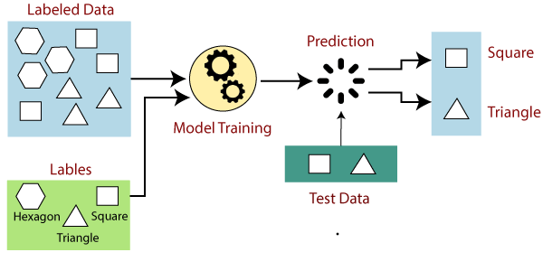
How Supervised Learning Works?
In supervised learning, models are trained using labelled dataset, where the model learns about each type of data.

Slide 3
How Supervised Learning Works?
Suppose we have a dataset of different types of shapes which includes square, rectangle, triangle, and Polygon. Now the first step is that we need to train the model for each shape.
  If the given shape has four sides, and all the sides are equal, then it will be labelled as a Square.
  If the given shape has three sides, then it will be labelled as a triangle.
  If the given shape has six equal sides then it will be labelled as hexagon.

Slide 4
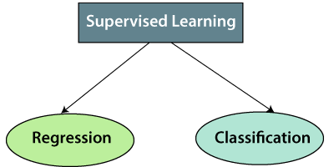
Types of supervised Machine learning Algorithms:
Split the training dataset into training dataset, test dataset, and validation dataset.
Supervised learning can be further divided into two types of problems:

Slide 5
Regression
Regression algorithms are used if there is a relationship between the input variable and the output variable.
It is used for the prediction of continuous variables, such as Weather forecasting, Market Trends, etc.
Regression algorithms under SL
  Linear Regression
  Regression Trees
  Non-Linear Regression
  Bayesian Linear Regression
  Polynomial Regression

Slide 6
Classification
Classification algorithms are used when the output variable is categorical, which means there are two classes such as Yes-No, Male-Female, True-false, etc.
  Random Forest
  Decision Trees
  Logistic Regression
  Support vector Machines

Slide 7
Advantages of Supervised learning:
With the help of SL, the model can predict the output on the basis of prior experiences.
In SL, we can have an exact idea about the classes of objects.
SL model helps us to solve various real-world problems such as fraud detection, spam filtering, etc.

Slide 8
Disadvantages of supervised learning:
SL models are not suitable for handling the complex tasks.
SL cannot predict the correct output if the test data is different from the training dataset.
Training required lots of computation times.
In SL, we need enough knowledge about the classes of object.

